Slide 1
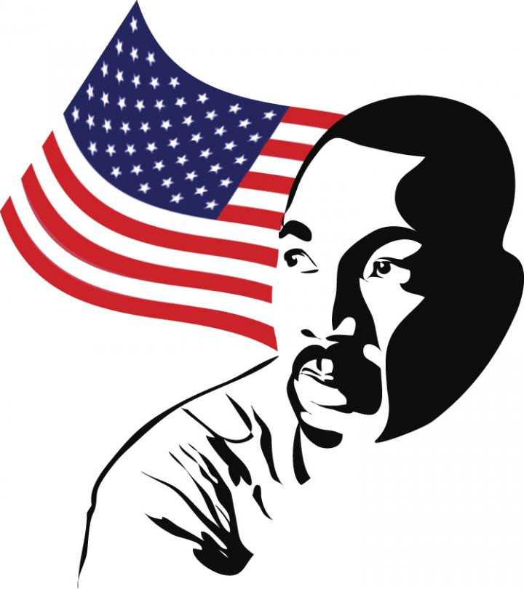
CHAPTER 13: CIVIL RIGHTS

Slide 2
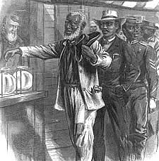
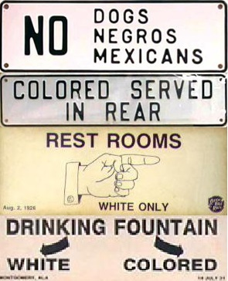
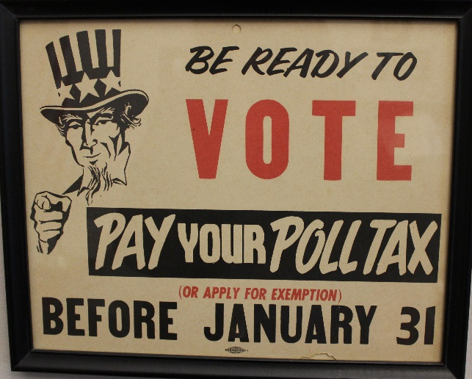
I. Road to Civil Rights
Civil War & Reconstruction
13th Amendment – Freed the slaves
14th Amendment –
Citizenship
Equal Protection Clause – Gov’t would treat all citizens the same
15th Amendment – Right to vote cannot be denied based on race
Still African Americans disenfranchised
Poll taxes, grandfather clause & literacy tests
White primary
Jim Crow laws based on Plessy v. Ferguson
“Separate but equal”

Slide 3
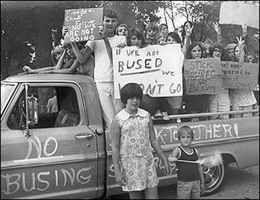
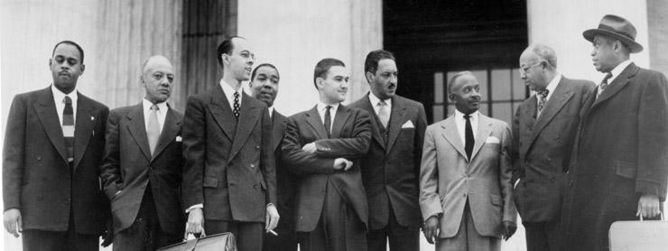
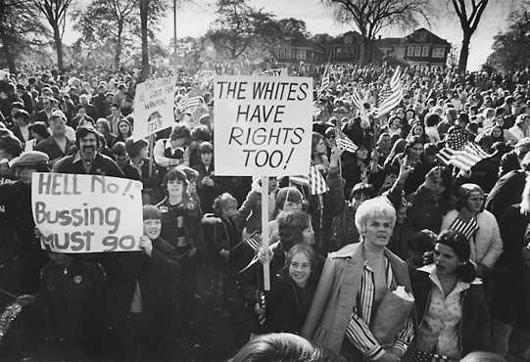
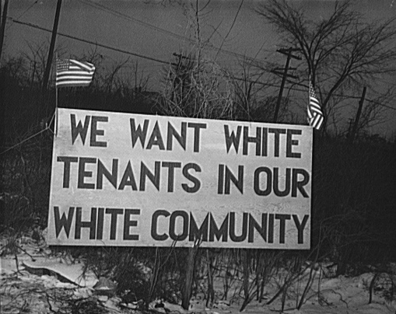
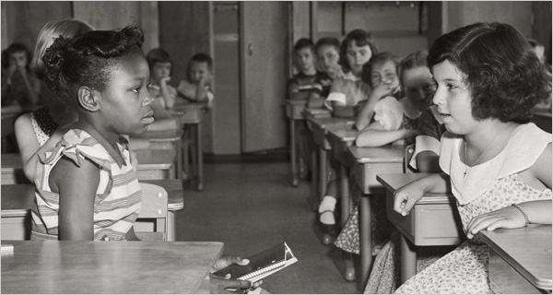
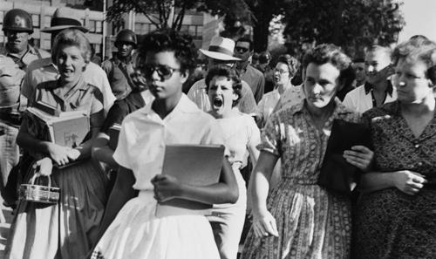
II. Civil Rights Movement
NAACP & their legal defense fund
Brown v. Board of Education
Chief Justice Earl Warren
Separate schools can never be equal
Little Rock Nine
De facto segregation remained
Freedom-of-choice plans – black students had to apply for a transfer to a white school
White communities would not sell or rent homes to blacks
Swann v. Charlotte-Mecklenburg schools
Schools should have same white-black ratio as the district
Required extensive school busing
“White Flight” – Many white parents moved their children to private schools

Slide 4
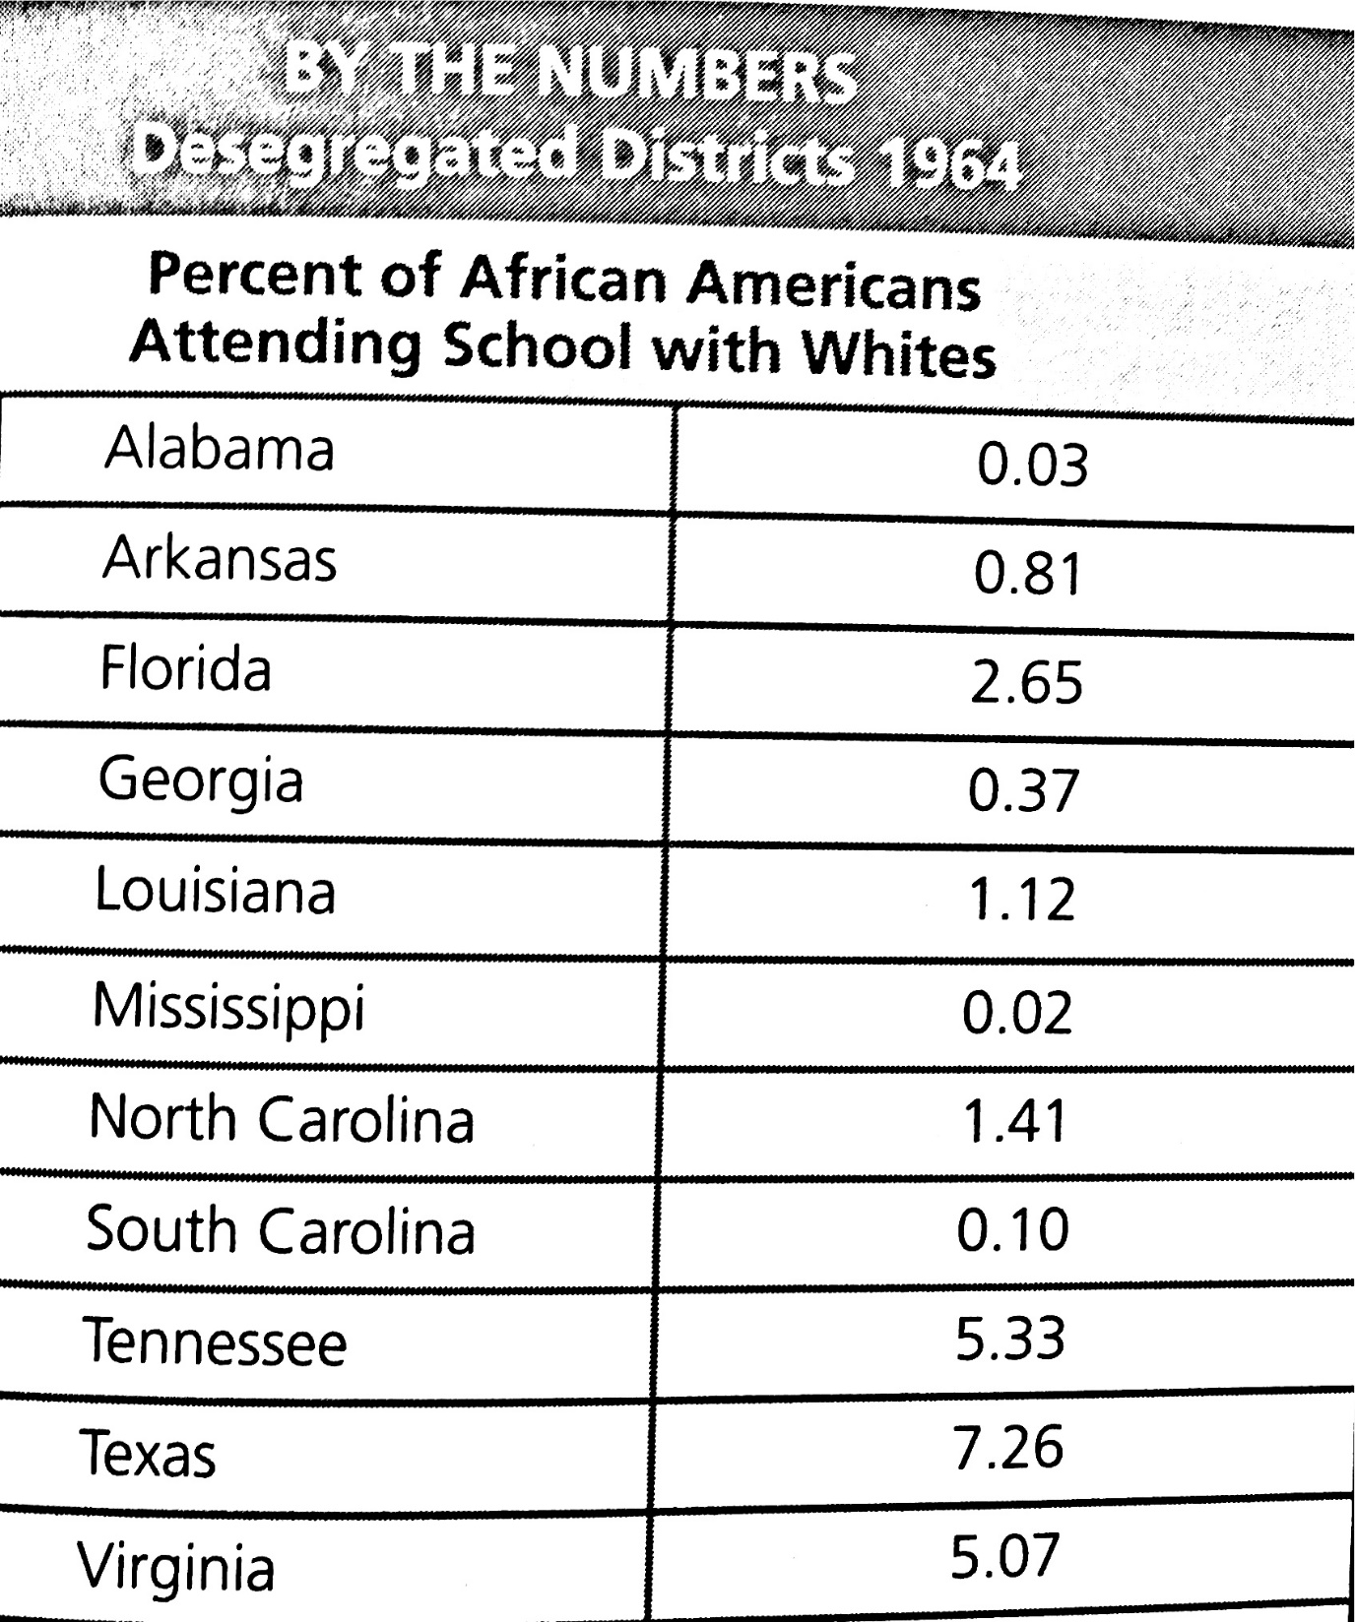
Even after the Brown decision many southern schools were slow to desegregate

Slide 5
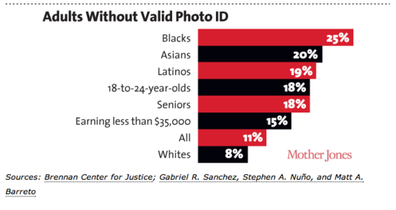
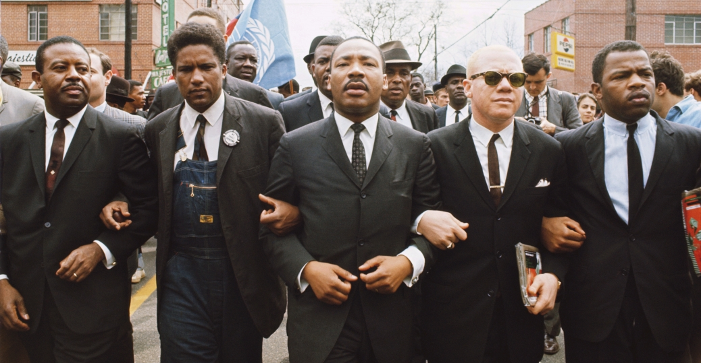
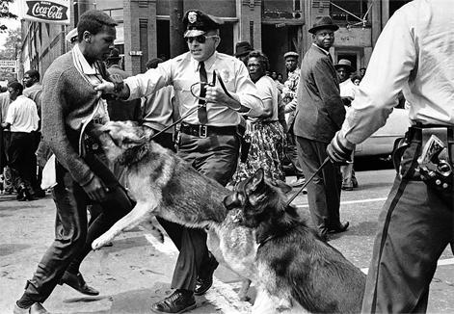
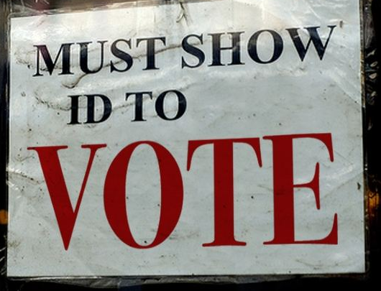
II. Civil Rights Movement
President JFK pushed for Civil Rights legislation
LBJ continued attempt after assassination
1964 Civil Rights Act
Banned discrimination in public places and in hiring
24th Amendment outlawed poll taxes
March on Selma for full voting rights
Attacked by police
1965 Voting Rights Act
Ended literacy tests & allowed federal gov’t to monitor elections
Some have argued that voter ID laws impede voting

Slide 6
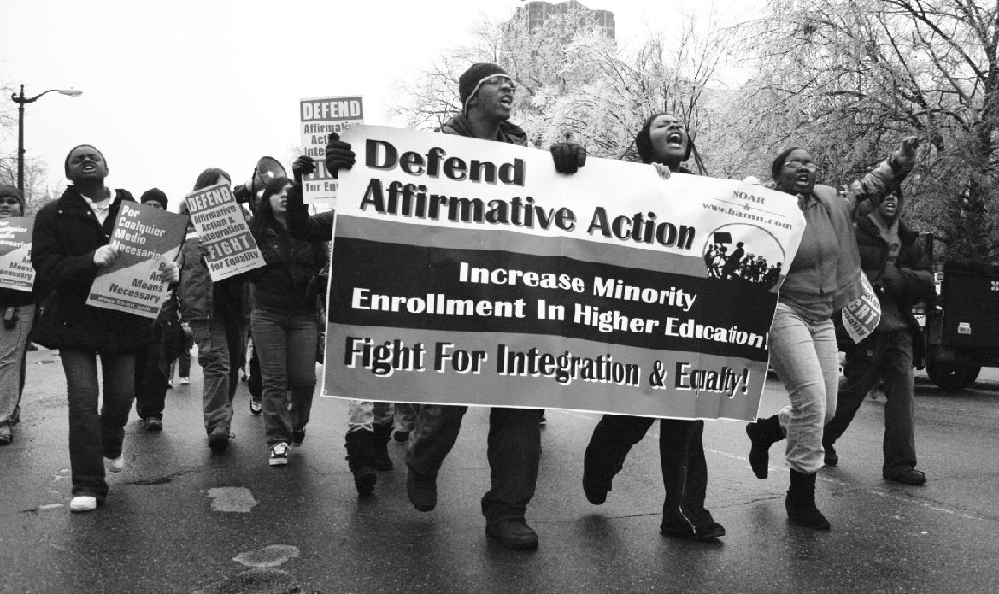
II. Civil Rights Movement
Affirmative Action – attempt to create an equal environment
Should colleges and gov’t institutions be blind to race?
University of California v. Bakke (1978)
Schools cannot issue mandatory quotas based on race

Slide 7
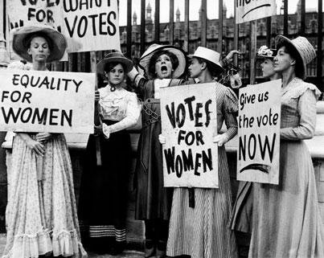
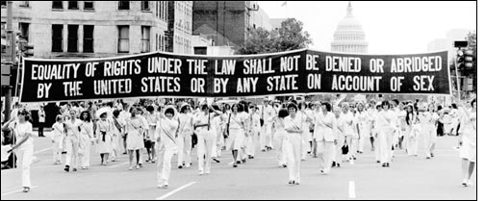
III. Other groups
1848 Seneca Falls, NY
19th Amendment (1920) gave women the national right to vote
1963 Equal Pay Act
Betty Friedan formed N.O.W.
Roe v. Wade
Title IX
Equal educational/sports opportunities at college level
Equal Rights Amendment was never passed

Slide 8
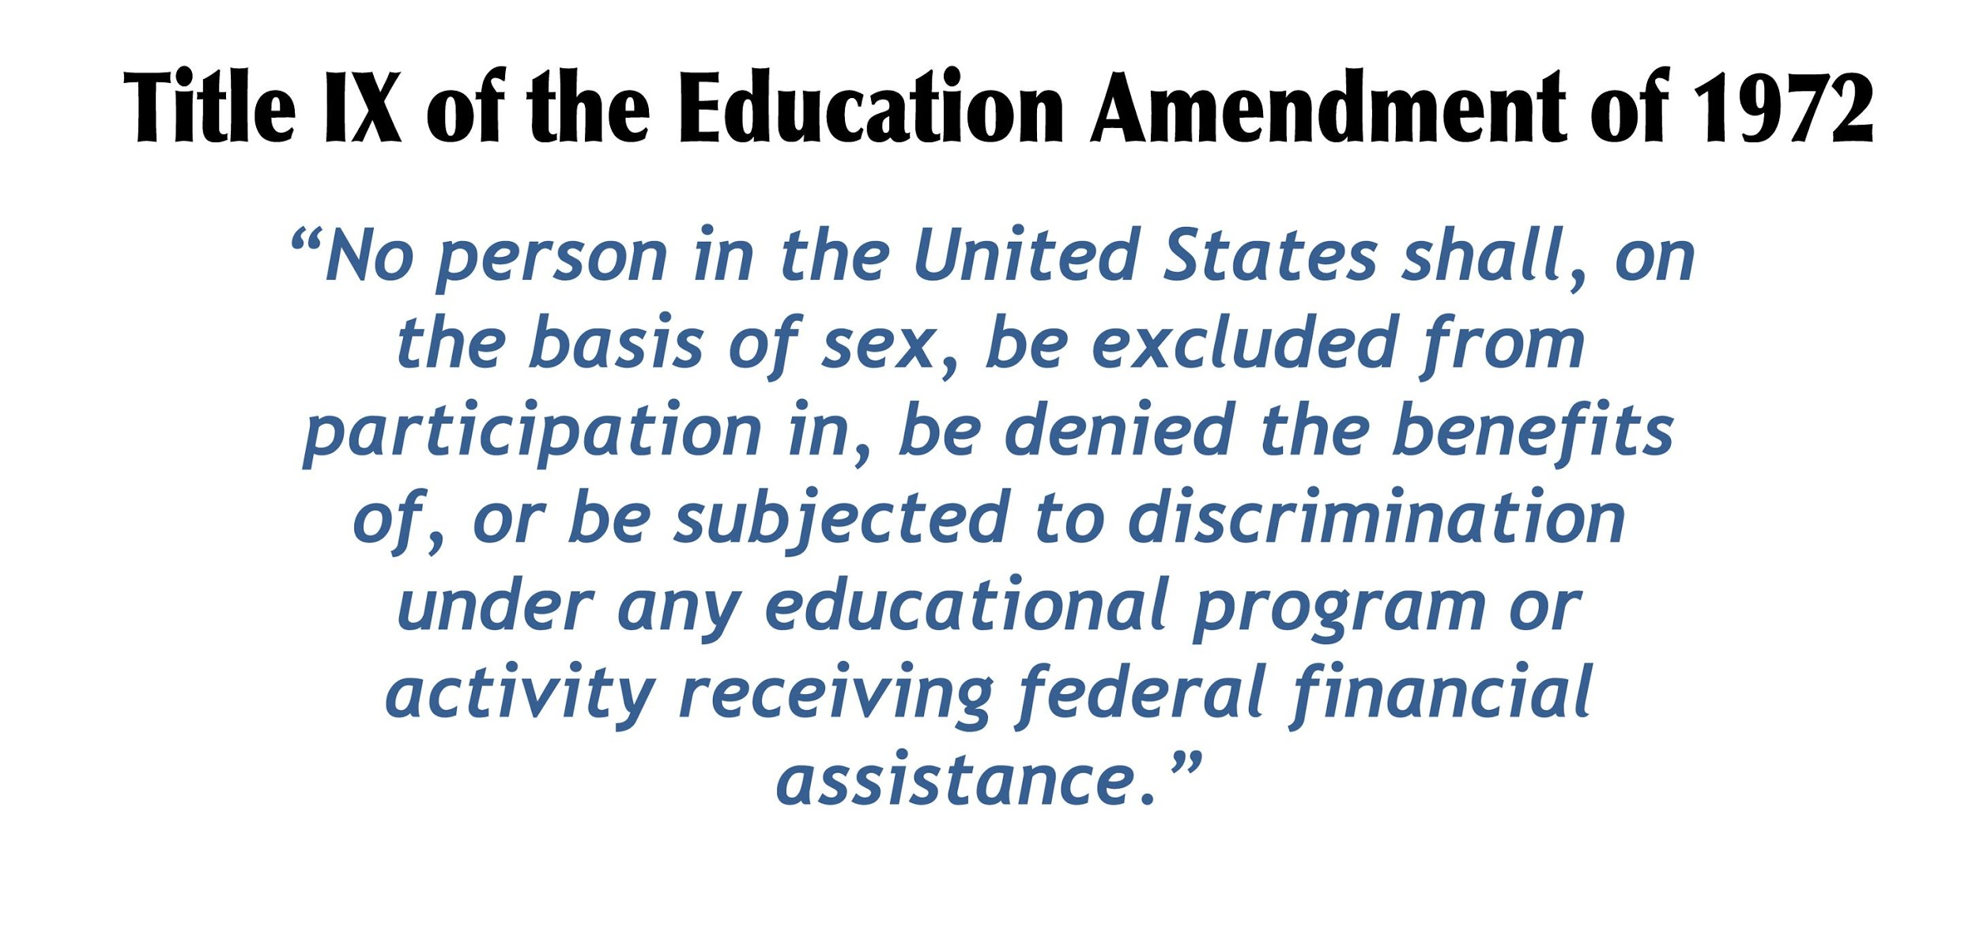

Slide 9
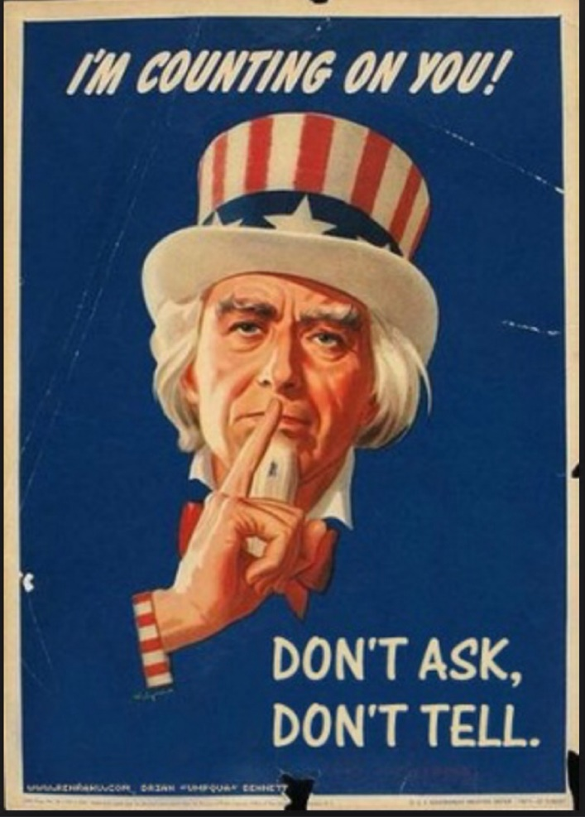
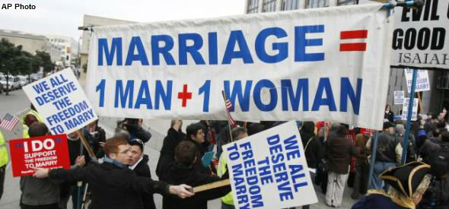
III. Other groups
Gay Rights
“Don’t ask, Don’t tell” – Bill Clinton
Lawrence v. Texas (2003) – states cannot outlaw homosexual activity
1996 Defense of Marriage Act (DOMA)
Obergefell v. Hodges (2015) – gave right to marry to gay couples

Slide 10
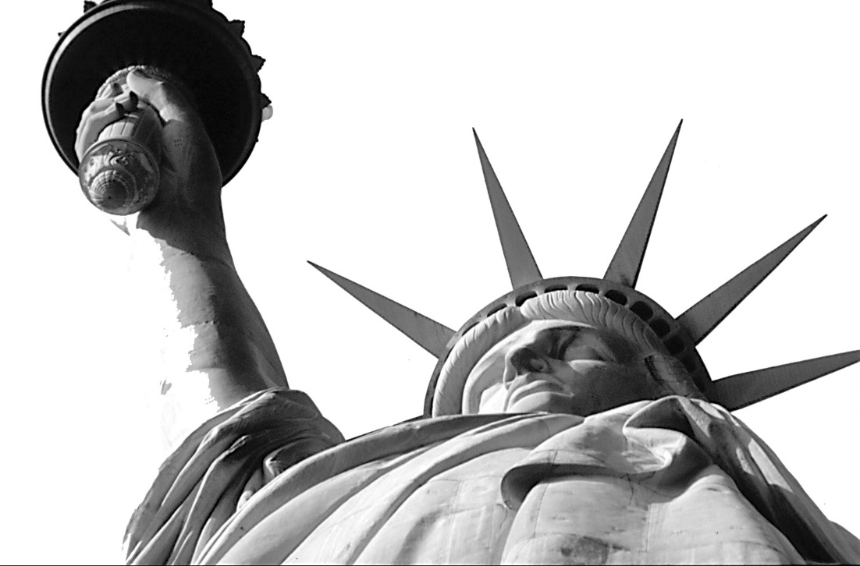
CHAPTER 14: CIVIL LIBERTIES

Slide 11
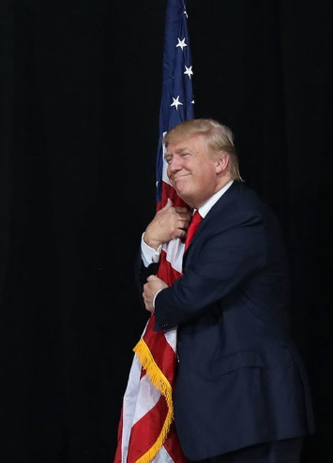
I. First Amendment Rights
The Bill of Rights & subsequent Amendments have secured liberties for all Americans
States must adhere to these → Incorporation
1st Amendment protects speech
Schenck v. United States
Government can limit speech in “clear and present danger”
Yates v. United States
Cannot organize to overthrow the government
What about flag burning?
Free speech in school?
Tinker v. Des Moines Independent Schools – students allowed to wear armbands to protest the Vietnam War

Slide 12
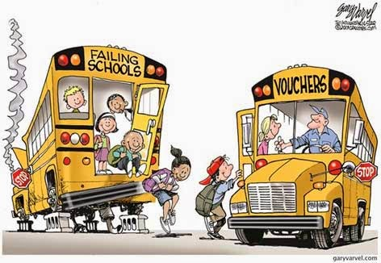
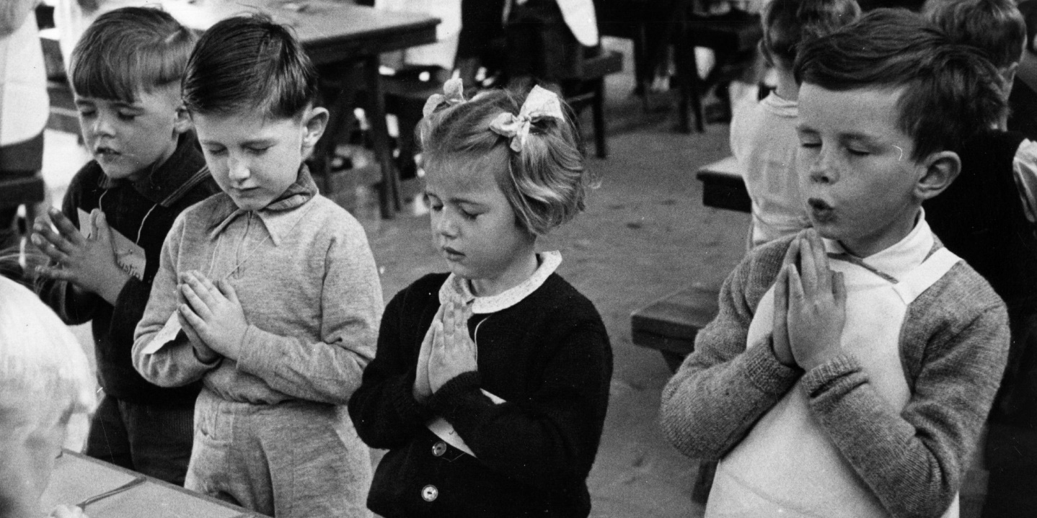
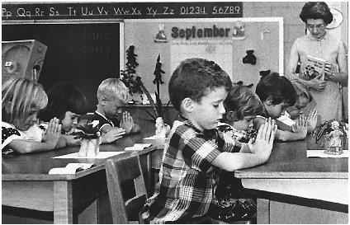
I. First Amendment Rights
1st Amendment protects religious freedom
Engle v. Vitale (1962) – Outlawed school prayer
Lemon v. Kurtzman (1971)- Gov’t can not pay teachers in Christian schools even if they teach secular subjects
Lemon Test: No relationship btwn religion & gov’t that entangles either in the affairs of the other
Vouchers?
Students permitted to pray, discuss religion & join religious clubs at school

Slide 13
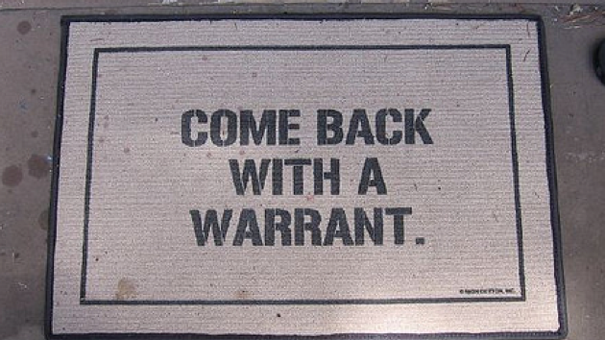
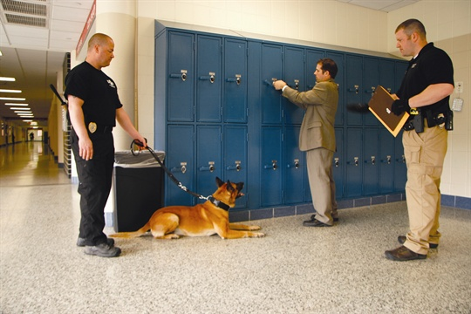
II. Search and Seizures
4th Amendment
Police must obtain a warrant
Mapp v. Ohio – Evidence taken unlawfully must be excluded in court “Exclusionary Rule”
New Jersey v. TLO – School administrators can conduct searches without warrant

Slide 14
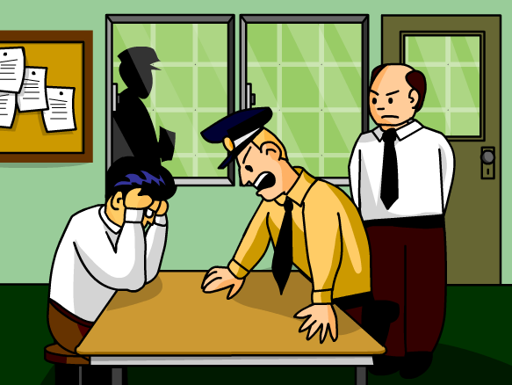
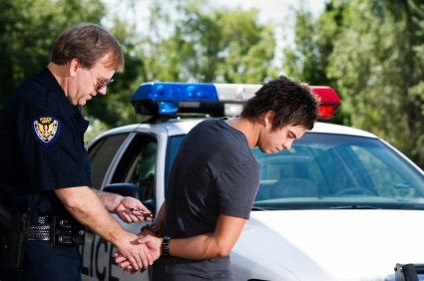
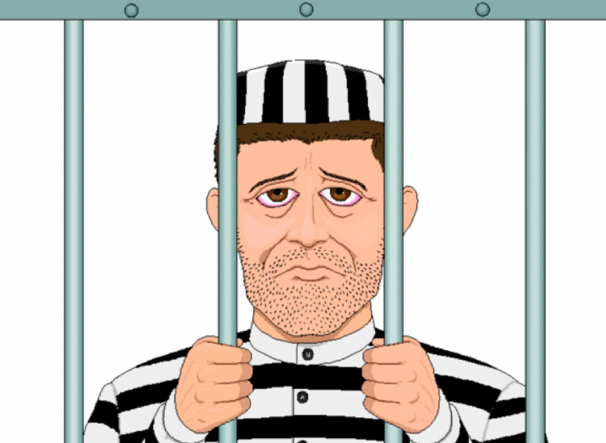
III. Crime and Punishment
5th Amendment – ensures the accused of a fair trial – “Due Process”
Miranda v. Arizona
Police coerced confessions
Suspects must be informed of their right to remain silent (self incrimination)
8th Amendment – protects against cruel and unusual punishment
What about the Death Penalty?

Slide 15
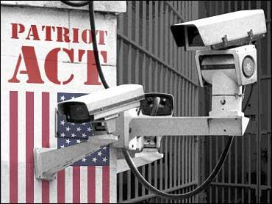
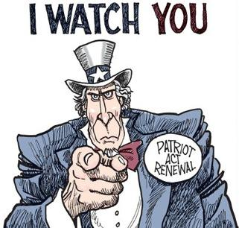
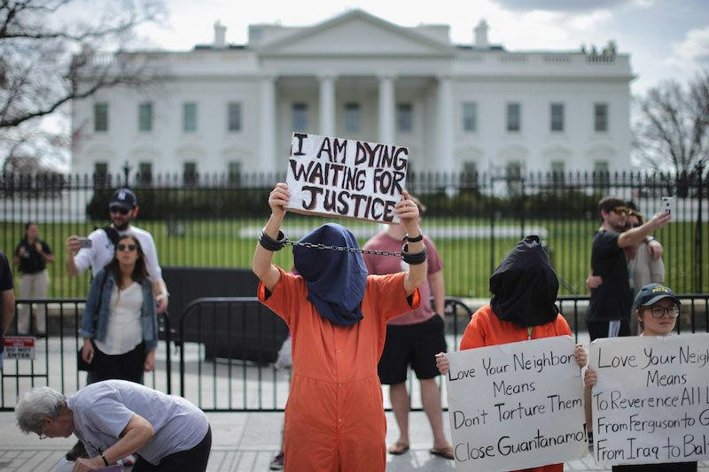
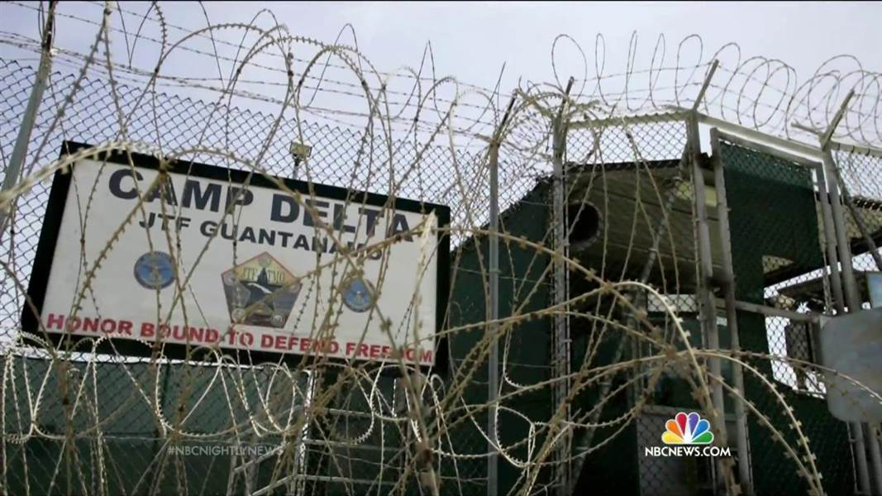
IV. National Security
Korematsu v. United States – Court supported Japanese internment policy
USA Patriot Act signed after 9/11 – surveillance of citizens
Should suspected terrorists be tried in criminal courts?
Should detainees at Guantanamo Bay be given a fair trial?
Is “intense interrogation” torture?

Slide 16
FRQ Practice:
Before 1954 several states segregated their citizens according to race. Activists fought a long battle to desegregate schools in the Unites States before and after Brown v. Board of Education.
Identify the constitutional provision that allowed states to segregate their citizens.
Identify the constitutional provision that allowed civil rights activists to overturn racial segregation in the courts
Identify two factors that delayed the full implementation of the Supreme Court’s Brown v. Board school segregation ruling.
Explain two factors that have assisted the desegregation process since the Brown ruling.

Slide 17
FRQ Practice
Women’s rights advocates have sought equality through Congress and through the Supreme Court with varying degrees of success.
Define the Nineteenth Amendment to the Constitution and explain how the amendment altered the struggle for women’s rights.
Identify and explain one act of Congress that enhances equality for women and discuss the effect of that act.
Identify and explain two relevant Supreme Court decisions and discuss how the Court’s decisions affected women’s quest for equality.

