Slide 1
Perspecitves
ZOOM

Slide 2
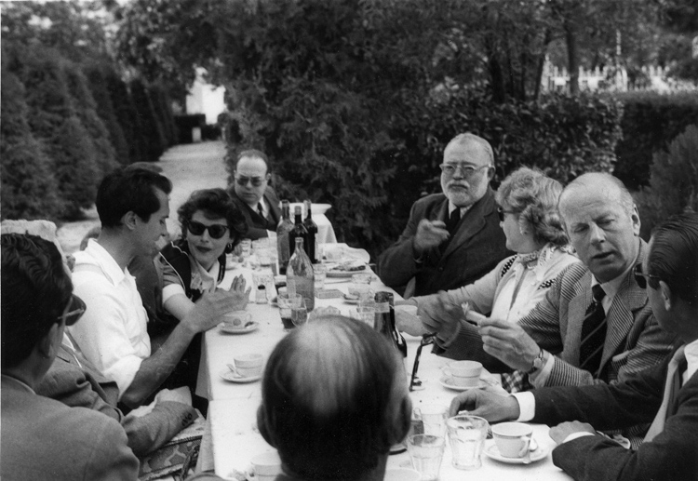
Introducing Multiple Perspectives
The Dinner Conversation

Slide 3
Multiple Perspectives
When introducing multiple perspectives it is not enough to just have different viewpoints, you need to explain the relationship between the perspectives and the relevance of the perspective to the topic.

Slide 4
Multiple Perspectives can be better understood if you think about a conversation at a dinner party. In order to have a successful dinner party you need to be selective about your guests.
Who are they?
Why would this person get along with the other guests?
What contribution would this person bring to the table that another guest does not already represent?

Slide 5
Definitions
Lens – how a particular topic is viewed; 8 are outlined by the Collegeboard
Environmental
Scientific
Economic
Political and Historical
Artistic and Philosophical
Cultural and Social
Futuristic
Ethical
Perspective – Questions about the topic that pertain to a particular lens

Slide 6
Topic
LENS
Perspective #1
Perspective #2
Perspective #3
Perspective #4

Slide 7
ADHD
Education
Teacher
Principal
Parent
Psychiatrist

Slide 8
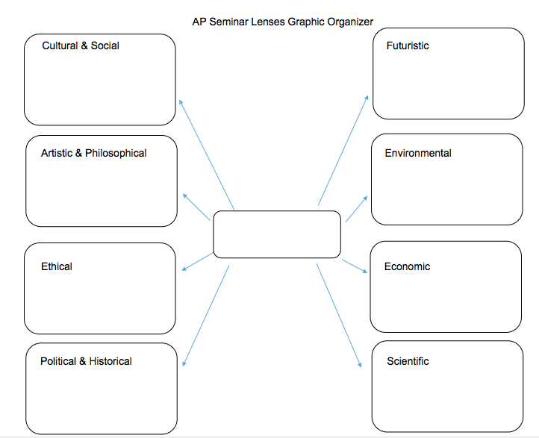

Slide 9
Multiple Perspectives
Dinner Conversation
Guest #1
Title:
Occupation:
POV:
Credibility:
Relevance:
Similarity:
Difference:
Guest #4
Title:
Occupation:
POV:
Credibility:
Relevance:
Similarity:
Difference:
Guest #2
Title:
Occupation:
POV:
Credibility:
Relevance:
Similarity:
Difference:
Topic
Guest #3
Title:
Occupation:
POV:
Credibility:
Relevance:
Similarity:
Difference:
Notes:
For the first time I introduce the activity I place the kids into groups, I assign a subject and they must produce a poster. Subsequently the teacher may want to reproduce this slide electronically (I use Google Classroom) and allow the kids to complete the form. I will have each group complete this process for their IRRs and for IWAs.

Slide 10
Guest #1
Title: Name and necessary identification.
Occupation: Where are they employed? What field?
POV: What is their perspective on this conversation?
Credibility: How is this individual credible on this particular subject?
Relevance: Why is their voice relevant to this particular conversation?
Similarity: What ideas/evidence does this person have that are similar to other ideas/evidence that have been shared?
Difference: What ideas/evidence does this person have that are different to other ideas/evidence that have been shared?

Slide 11
Instructions
While working in groups you will create a poster for your dinner party, I will assign your topics. Once you have the topic of your dinner conversation you will need to select the guests for your party, you may have between 4 to 6 guests at your party.
You will need to complete the template for each “guest”, if you are unable to complete any part of the questionnaire you need to get to know your “guests” better.
Your group will present their poster to the class in the second half of class tomorrow.
Notes:
In addition to reinforcing the skills related to developing and communicating multiple perspectives this activity also presents an opportunity to practice public speaking skills.

Slide 12
Topics
Group One: Use of Electronic Devices in Classrooms
Group Two: Funding for Arts Education
Group Three: Late Start Times for High School
Group Four: Effectiveness of School Uniform Policies
Group Five: Eliminating Mandatory Physical Education in High Schools
Notes:
I chose the topics based on issues the kids would be familiar with for which they should be able to identify at least four relevant and credible guests to invite to the party.

Slide 13
Multiple Perspectives
Dinner Conversation
Guest #1
Title:
Occupation:
POV:
Credibility:
Relevance:
Similarity:
Difference:
Guest #4
Title:
Occupation:
POV:
Credibility:
Relevance:
Similarity:
Difference:
Guest #2
Title:
Occupation:
POV:
Credibility:
Relevance:
Similarity:
Difference:
Topic
Guest #3
Title:
Occupation:
POV:
Credibility:
Relevance:
Similarity:
Difference:
Notes:
For the first time I introduce the activity I place the kids into groups, I assign a subject and they must produce a poster I will allow for two class periods. The first day is introduction of concept and starting the process. The second day is the completion and presentation of the poster. Subsequently the teacher may want to reproduce this slide electronically (I use Google Classroom) and allow the kids to complete the form. I will have each group complete this process for their IRRs and for IWAs.

Slide 14
Homework
Use your definition of “silence” and choose 3 lenses to view this topic through.
Identify one perspective for each lens and find one source for each question. (Your art piece can be used for 1 of the sources)
Summarize/explain your source, give the relevance to the perspective and explain how each source compares to the others (are the views conflicting, similar, or completely different and how?).
Read and annotate the article “Your Brain on Silence”.

Slide 15
Your Brain on Silence – Carousel Activity
Find your group and turn desks to face each other. Have your article with you!
Use the time in your group to complete the task presented.
Rotate when instructed

Slide 16
Task #1
Within your group, decide on the Central Claim (thesis) of the article.
Write it on your poster using a quotation.

Slide 17
Task #2
Your group should add two Supporting Claims.
(What points does the author make to support the thesis?)
Don’t forget your quotations.

Slide 18
Task #3
Add a piece of evidence used in the article that connects to each of the supporting claims.

Slide 19
Task #4
Do the claims and evidence used in the article strengthen it?
Why? How?
What else helps to make this a valid resource?

Slide 20
Task #5
Back to your original Central Claim poster.
Review what’s been added by the other groups.
On your poster, add why you think that Mrs. Gaulden and Mrs. Flood chose this article and why they think it’s an important piece for you to work with.

Slide 21
Wrap Up/Homework
- What makes a well-written article?
- How do we know when an article is valid? Why should we even consider validity?
- What about citations? Is this author plagiarizing?
- What are some of the lenses at play in this article? Explain why you chose each.
- What is one research question that you could develop from a close-reading of this article? (Be sure it is not a “yes/no” question)

