Slide 1
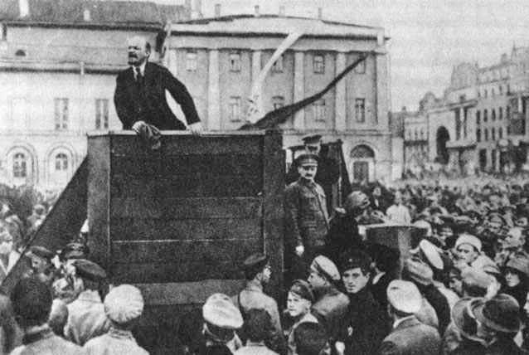
© Students of History - http://www.teacherspayteachers.com/Store/Students-Of-History

Slide 2
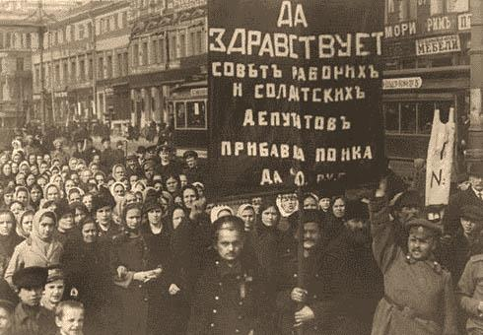
Czar – Absolute Monarch/ruler of Russia
Proletariat – lowest class in a society, (mostly industrial workers)
Bourgeoisie – the middle class
Bolsheviks – Communist majority portion of the Russian Social Democratic Workers Party
© Students of History - http://www.teacherspayteachers.com/Store/Students-Of-History

Slide 3
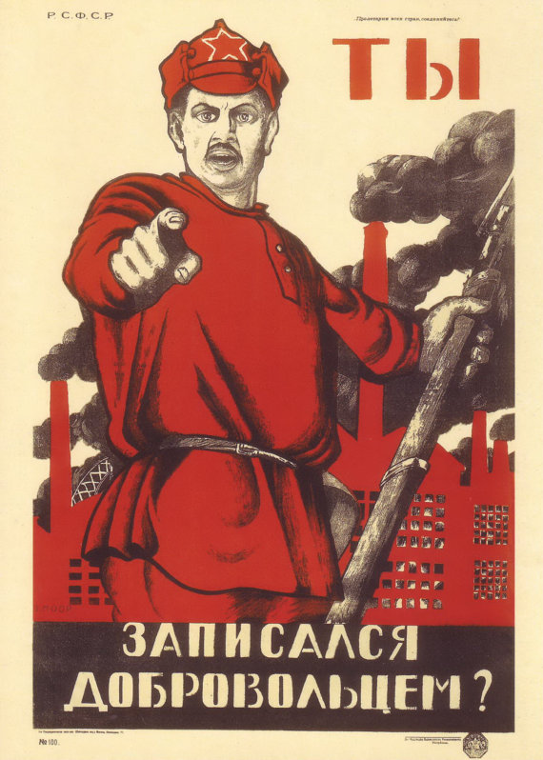
Romanov – royal family who ruled Russia for 300 years
Totalitarianism – Absolute unlimited power by a ruler
Soviet – elected councils formed during the Revolution

Slide 4
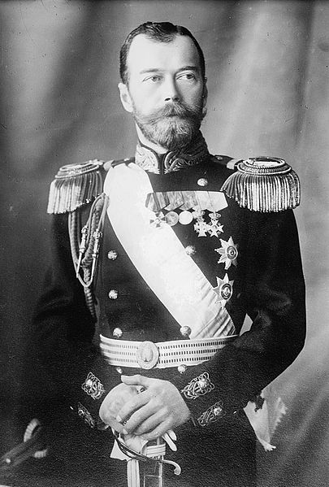
Only true autocracy left in Europe
People had no say in government
Nicholas II became Tsar in 1884
Marxist ideas become popular
Russia suffers humiliating defeat in the Russo-Japanese War

Slide 5
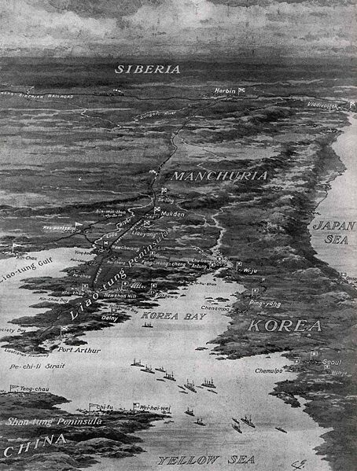
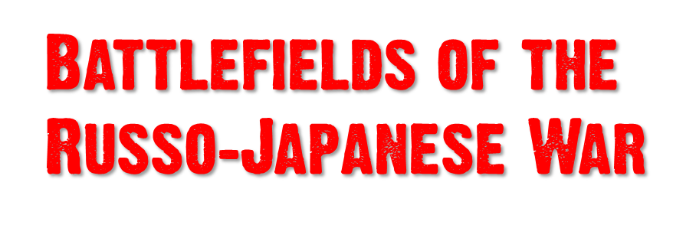

Slide 6
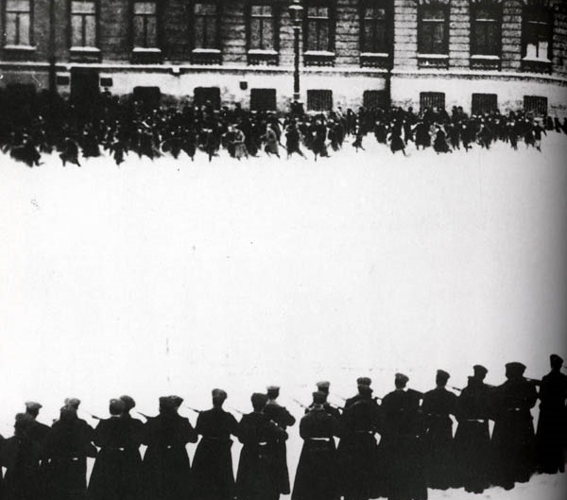
Thousands of discontented workers & poor peacefully protest
better working conditions & suffrage
The czar’s guards fire into the crowd
sparked widespread strikes and uprisings
The Duma (Russian Congress) was allowed more power temporarily
Nichols dissolved the Duma within weeks

Slide 7
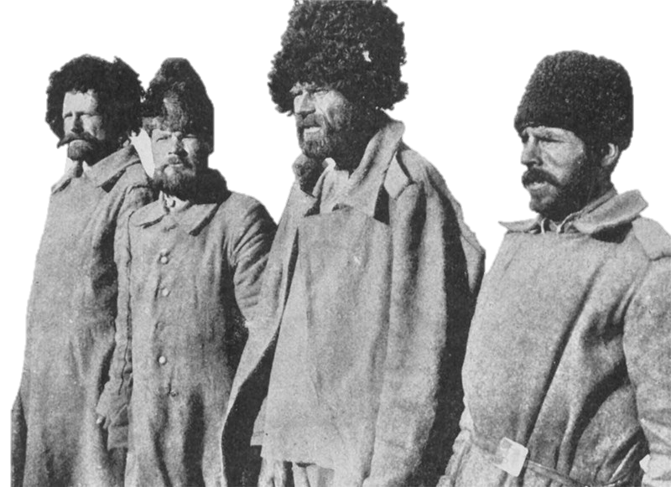
Nicholas brings Russia into WWI.
Poorly supplied troops result in massive casualties
Nicholas went to
“run” the military on
the eastern front.
(BAD NEWS!)

Slide 8
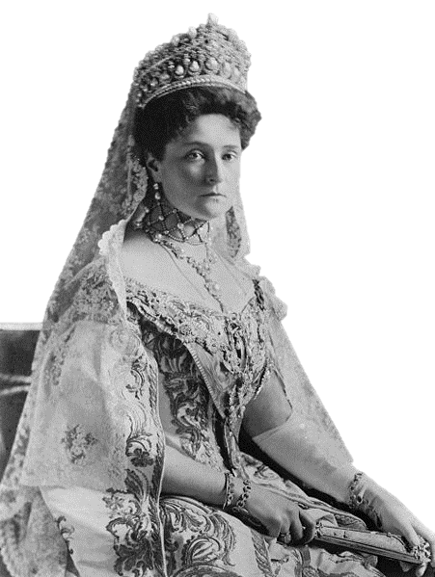
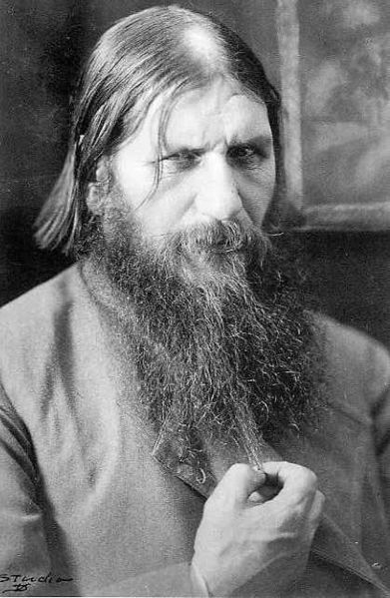
Czarina Alexandra ran the government
She was heavily influenced by Rasputin – a mystical “holy man”
Scandals surrounding Rasputin served to discredit the monarchy

Slide 9
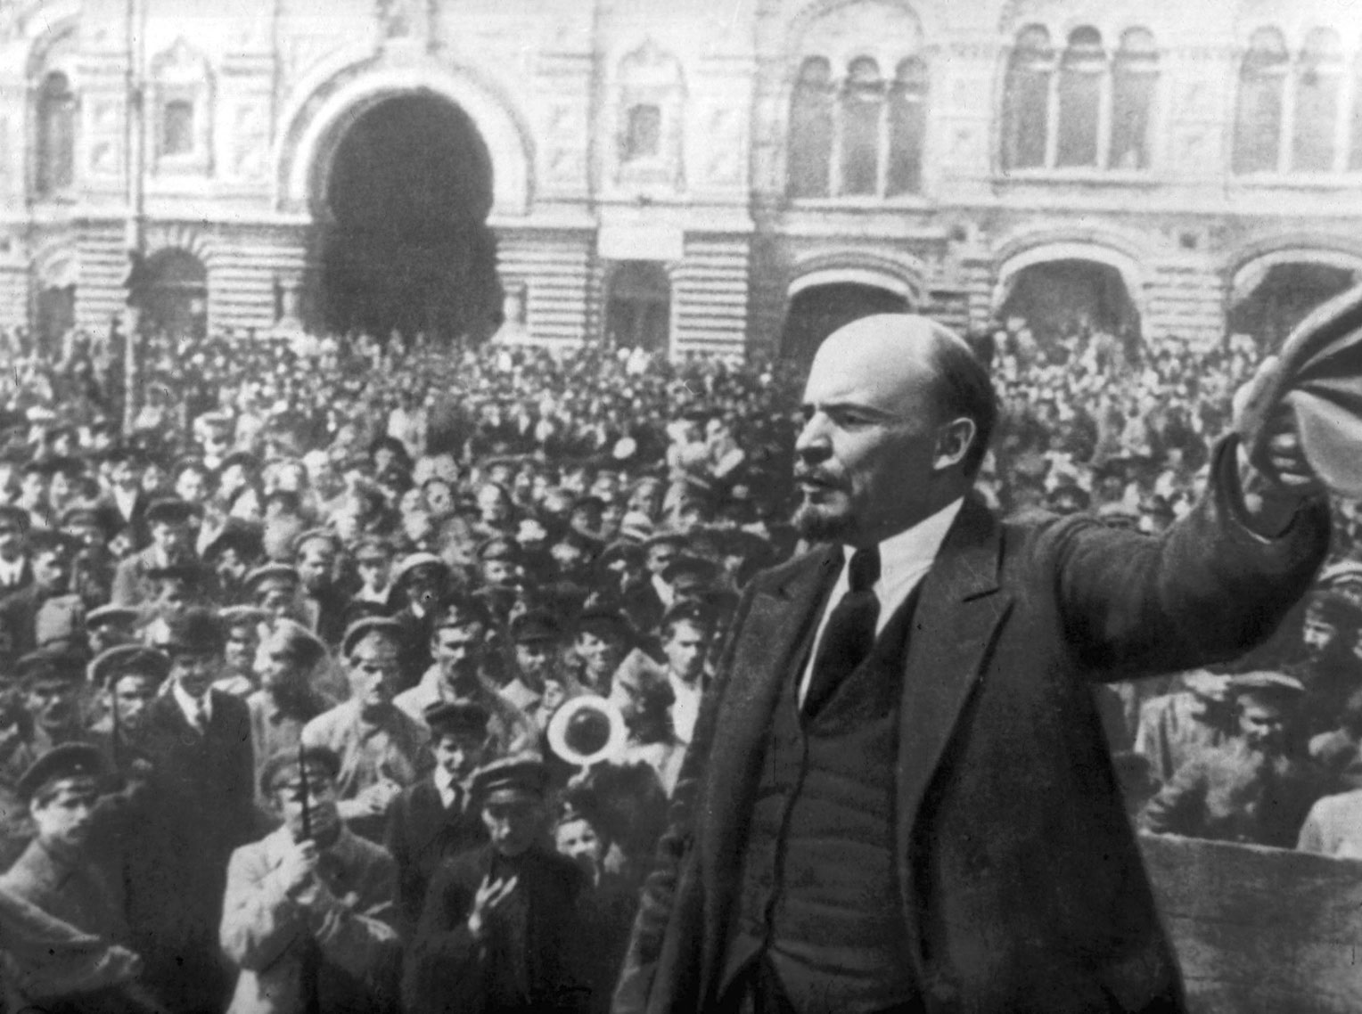
Leading Marxist revolutionary
Committed to class struggle and revolution
Exiled to Siberia for anti-czarist protests
Later fled to Western Europe
Returns to take the lead with the help of the Germans
© Students of History - http://www.teacherspayteachers.com/Store/Students-Of-History

Slide 10
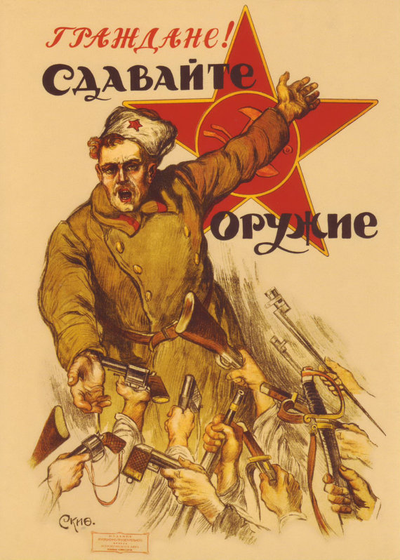
Starts with riots, strikes, and protests against the war
The Duma declares itself a Provisional Government
Formed SOVIETS – local councils
Czar Nicholas abdicates the throne (steps down)
Lenin and his Bolsheviks return
Notes:
Poster reads: “Citizens. Give us your weapons”

Slide 11
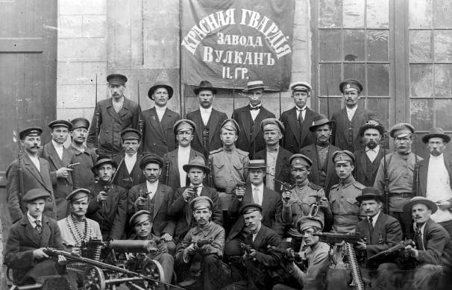
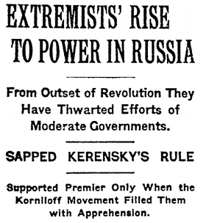
Bolsheviks take over
All private property of wealthy was abolished and divided among the peasantry

Slide 12
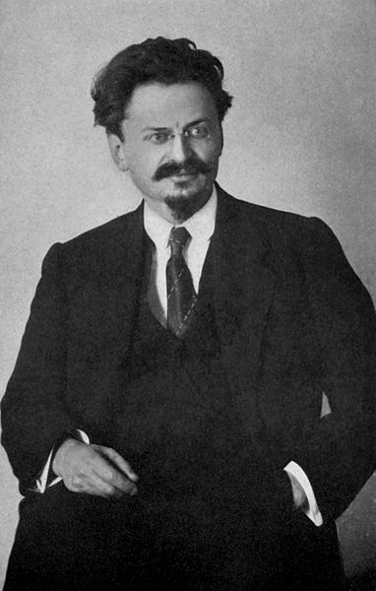
Revolutionary army created with Leon Trotsky in charge -the “Red Army”
Bolshevik Party renamed Communist Party in March of 1918
Notes:
Leon Trotsky pictured

Slide 13
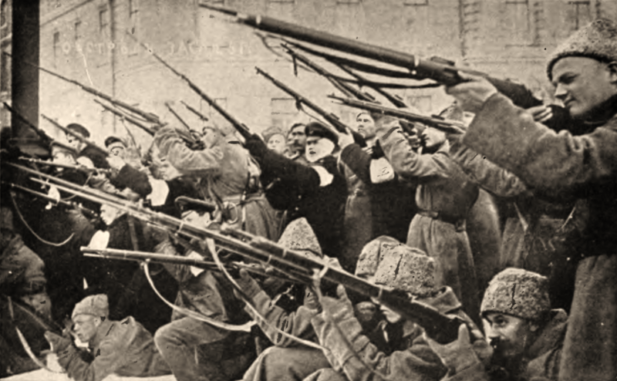
“Reds” versus “Whites”
“Reds” were the Bolsheviks & Red Army
“Whites” were army officers, bourgeoisie, cossacks, and moderate revolutionaries
Whites received support from England, France, USA, & Japan
Reds ultimately victorious

Slide 14
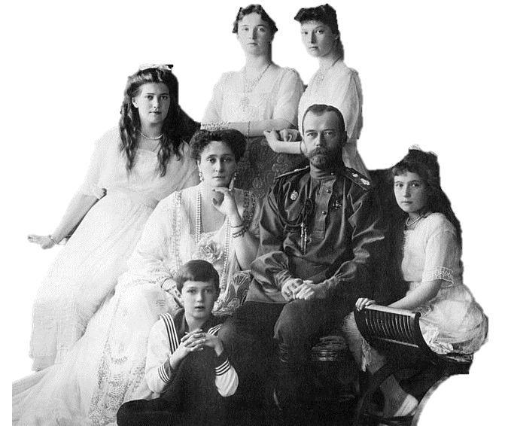
Placed under house arrest during the March Revolution
Czar Nicholas, Alexandra & their 5 children were executed in July 1917

Slide 15
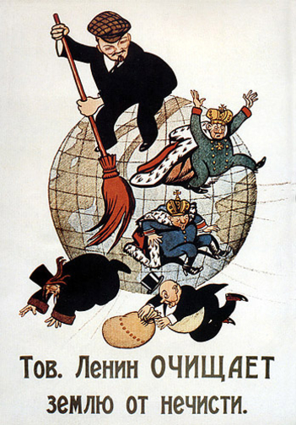
Lenin reorganized the country & renames it the Soviet Union in 1922
Communist!
Notes:
Russian propaganda poster from 1920, showing Lenin sweeping away monarchists and capitalists; the caption reads, "Comrade Lenin Cleanses the Earth of Filth"

Slide 16
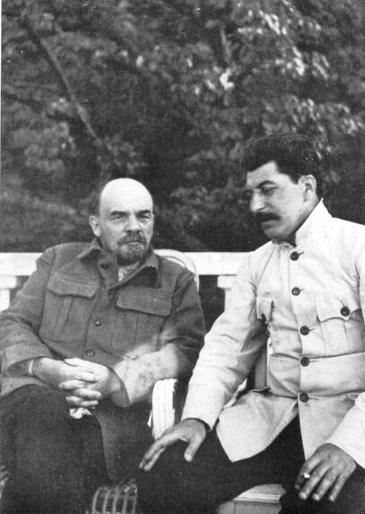
Stalin was a Bolshevik revolutionary
Came into power following Lenin’s death in 1924
Viciously eliminated any opposition
Notes:
Stalin pictured with Lenin

